Slide 1

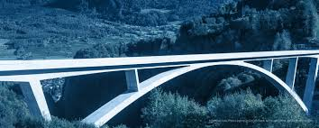
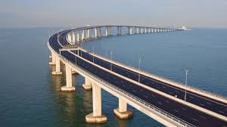
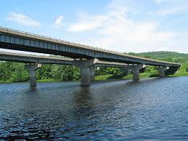
LAKSHMI NARAIN COLLEGE OF TECHNOLOGY, BHOPAL
Unit –III
Bridge Site Investigation and Planning
Transportation Engineering -I (CE-404). CE DEPT. PROF. VIJAY KUMAR MESHRAM

Slide 2
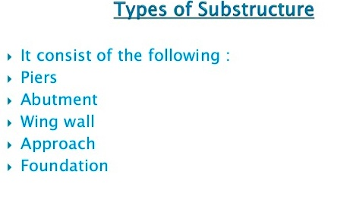
LAKSHMI NARAIN COLLEGE OF TECHNOLOGY, BHOPAL
Transportation Engineering -I (CE-404). CE DEPT. PROF. VIJAY KUMAR MESHRAM

Slide 3
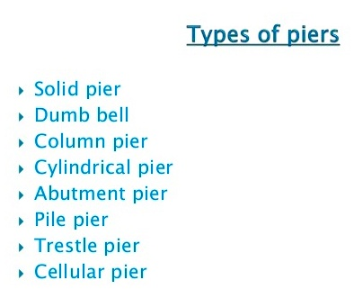
LAKSHMI NARAIN COLLEGE OF TECHNOLOGY, BHOPAL
Transportation Engineering -I (CE-404). CE DEPT. PROF. VIJAY KUMAR MESHRAM

Slide 4
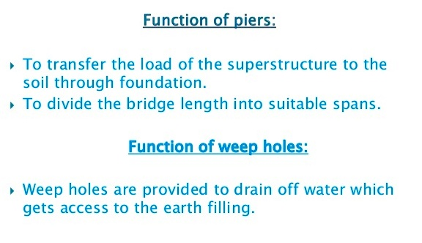
LAKSHMI NARAIN COLLEGE OF TECHNOLOGY, BHOPAL
Transportation Engineering -I (CE-404). CE DEPT. PROF. VIJAY KUMAR MESHRAM

Slide 5
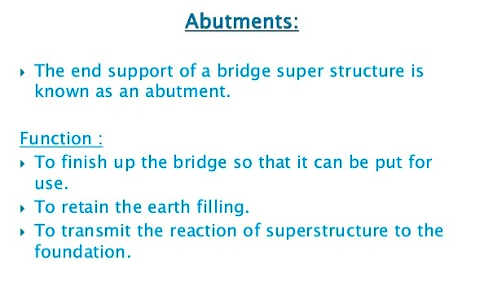
LAKSHMI NARAIN COLLEGE OF TECHNOLOGY, BHOPAL
Transportation Engineering -I (CE-404). CE DEPT. PROF. VIJAY KUMAR MESHRAM

Slide 6
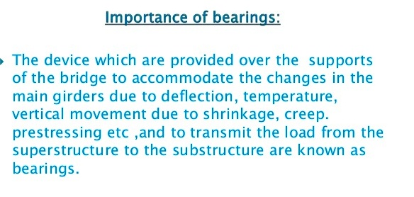
LAKSHMI NARAIN COLLEGE OF TECHNOLOGY, BHOPAL
Transportation Engineering -I (CE-404). CE DEPT. PROF. VIJAY KUMAR MESHRAM

Slide 7
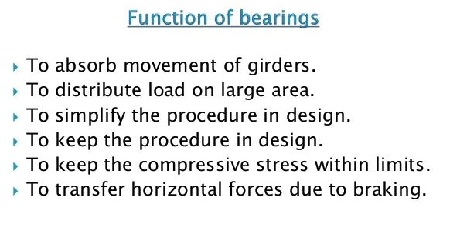
LAKSHMI NARAIN COLLEGE OF TECHNOLOGY, BHOPAL
Transportation Engineering -I (CE-404). CE DEPT. PROF. VIJAY KUMAR MESHRAM

Slide 8
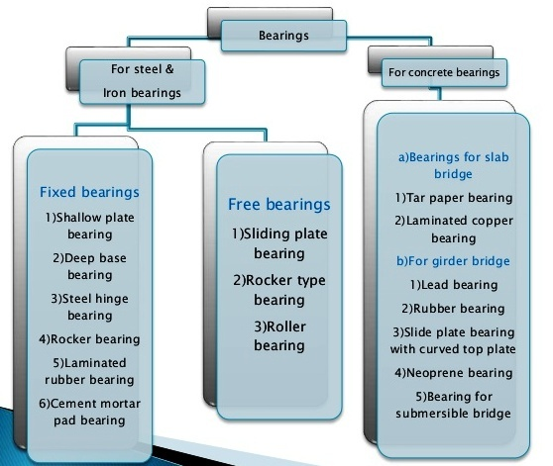
LAKSHMI NARAIN COLLEGE OF TECHNOLOGY, BHOPAL
Transportation Engineering -I (CE-404). CE DEPT. PROF. VIJAY KUMAR MESHRAM

Slide 9
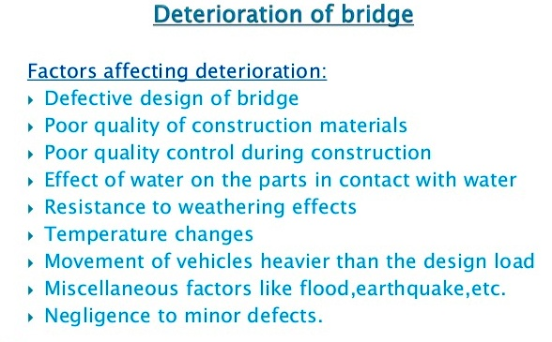
LAKSHMI NARAIN COLLEGE OF TECHNOLOGY, BHOPAL
Transportation Engineering -I (CE-404). CE DEPT. PROF. VIJAY KUMAR MESHRAM

Slide 10
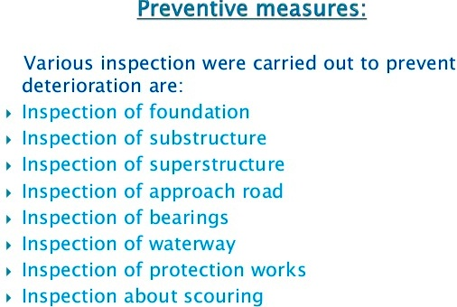
LAKSHMI NARAIN COLLEGE OF TECHNOLOGY, BHOPAL
Transportation Engineering -I (CE-404). CE DEPT. PROF. VIJAY KUMAR MESHRAM

Slide 11
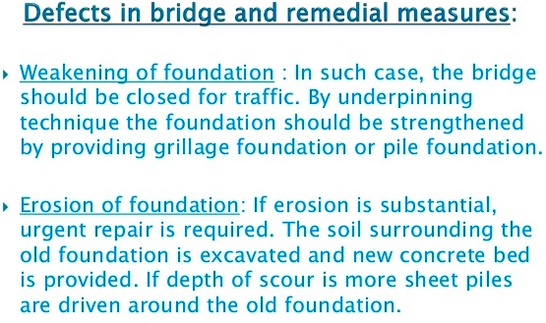
LAKSHMI NARAIN COLLEGE OF TECHNOLOGY, BHOPAL
Transportation Engineering -I (CE-404). CE DEPT. PROF. VIJAY KUMAR MESHRAM

Slide 12
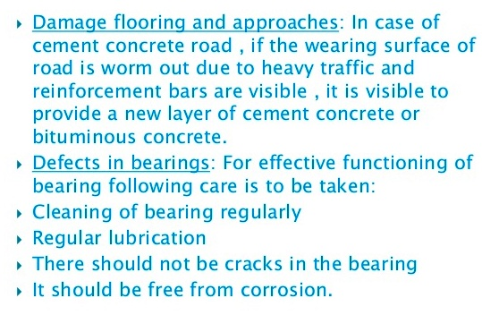
LAKSHMI NARAIN COLLEGE OF TECHNOLOGY, BHOPAL
Transportation Engineering -I (CE-404). CE DEPT. PROF. VIJAY KUMAR MESHRAM

